Slide 1
Community Award Application Overview
Bryttney Bailey
Georgia Council on Literacy
Project Coordinator
Bryttney.bailey@gosa.ga.gov
Ryan Hersh
The Sandra Dunagan Deal Center
Grants Administrator ryan.hersh@gcsu.edu
Notes:
Welcome, everyone! We’re thrilled to have you join us today. I’m Bryttney Bailey with the Georgia Council on Literacy, and alongside me is Ryan Hersh from the Sandra Dunagan Deal Center. Together, we’ll guide you through the Georgia Reads Community Award application process. By the end of this session, you’ll feel confident about what’s required and how to submit a strong application.

Slide 2
Session Outline:
Welcome and Introductions
Overview of Georgia Reads and Community Award
Application and Rubric Walkthrough
Data
Partnerships
Q&A
Conclude
** Please use chat for questions. As time permits, questions will be addressed at the end.
Notes:
Here’s our roadmap for today. We’ll start with a quick overview of Georgia Reads and the Community Award, then dive into the application and rubric. After that, we’ll focus on two critical areas—data and partnerships—before wrapping up with Q&A. Feel free to drop questions in the chat as we go; we’ll address as many as possible at the end.

Slide 3
How did we start?
SB 211 & HB 538 (2023)
The Governor, Lieutenant Governor, and Speaker of the House appointed thirty members to the Georgia Council on Literacy, which launched on July 1, 2023.
The Council is charged with monitoring and reporting on the implementation of the science of reading requirements, including teacher training, reading screeners, and interventions for students with reading difficulties.
Notes:
Let’s begin with a little background. The Georgia Council on Literacy was created through SB 211 and HB 538 in 2023. Thirty members were appointed by state leaders to monitor and report on the implementation of the science of reading requirements. This includes teacher training, reading screeners, and interventions for students who need extra support. Our mission is clear: to ensure literacy success across Georgia.

Slide 4
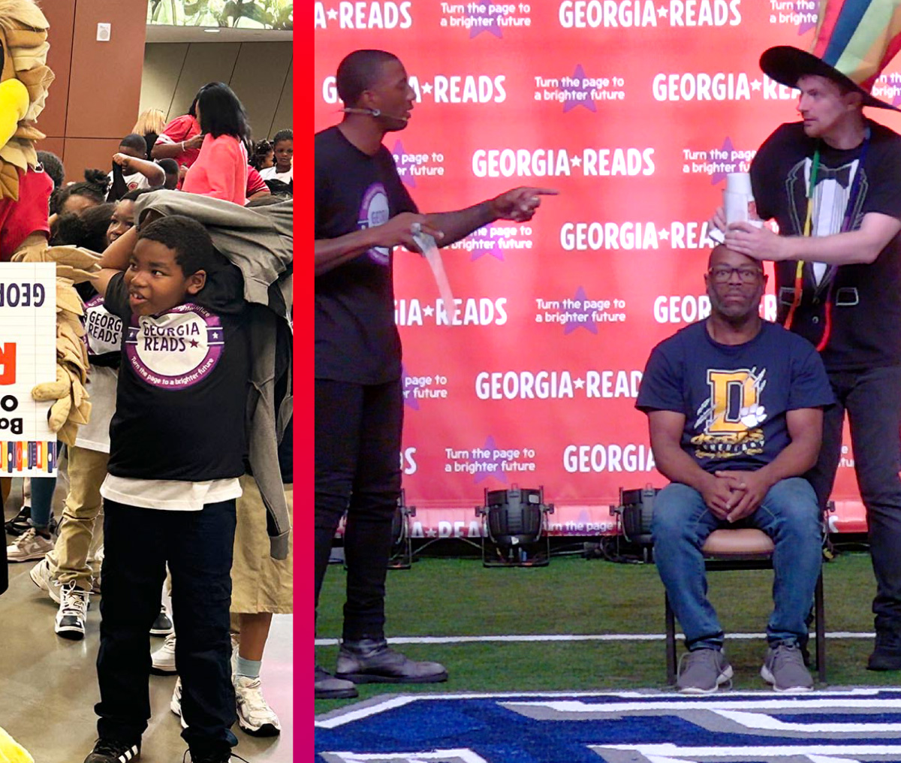
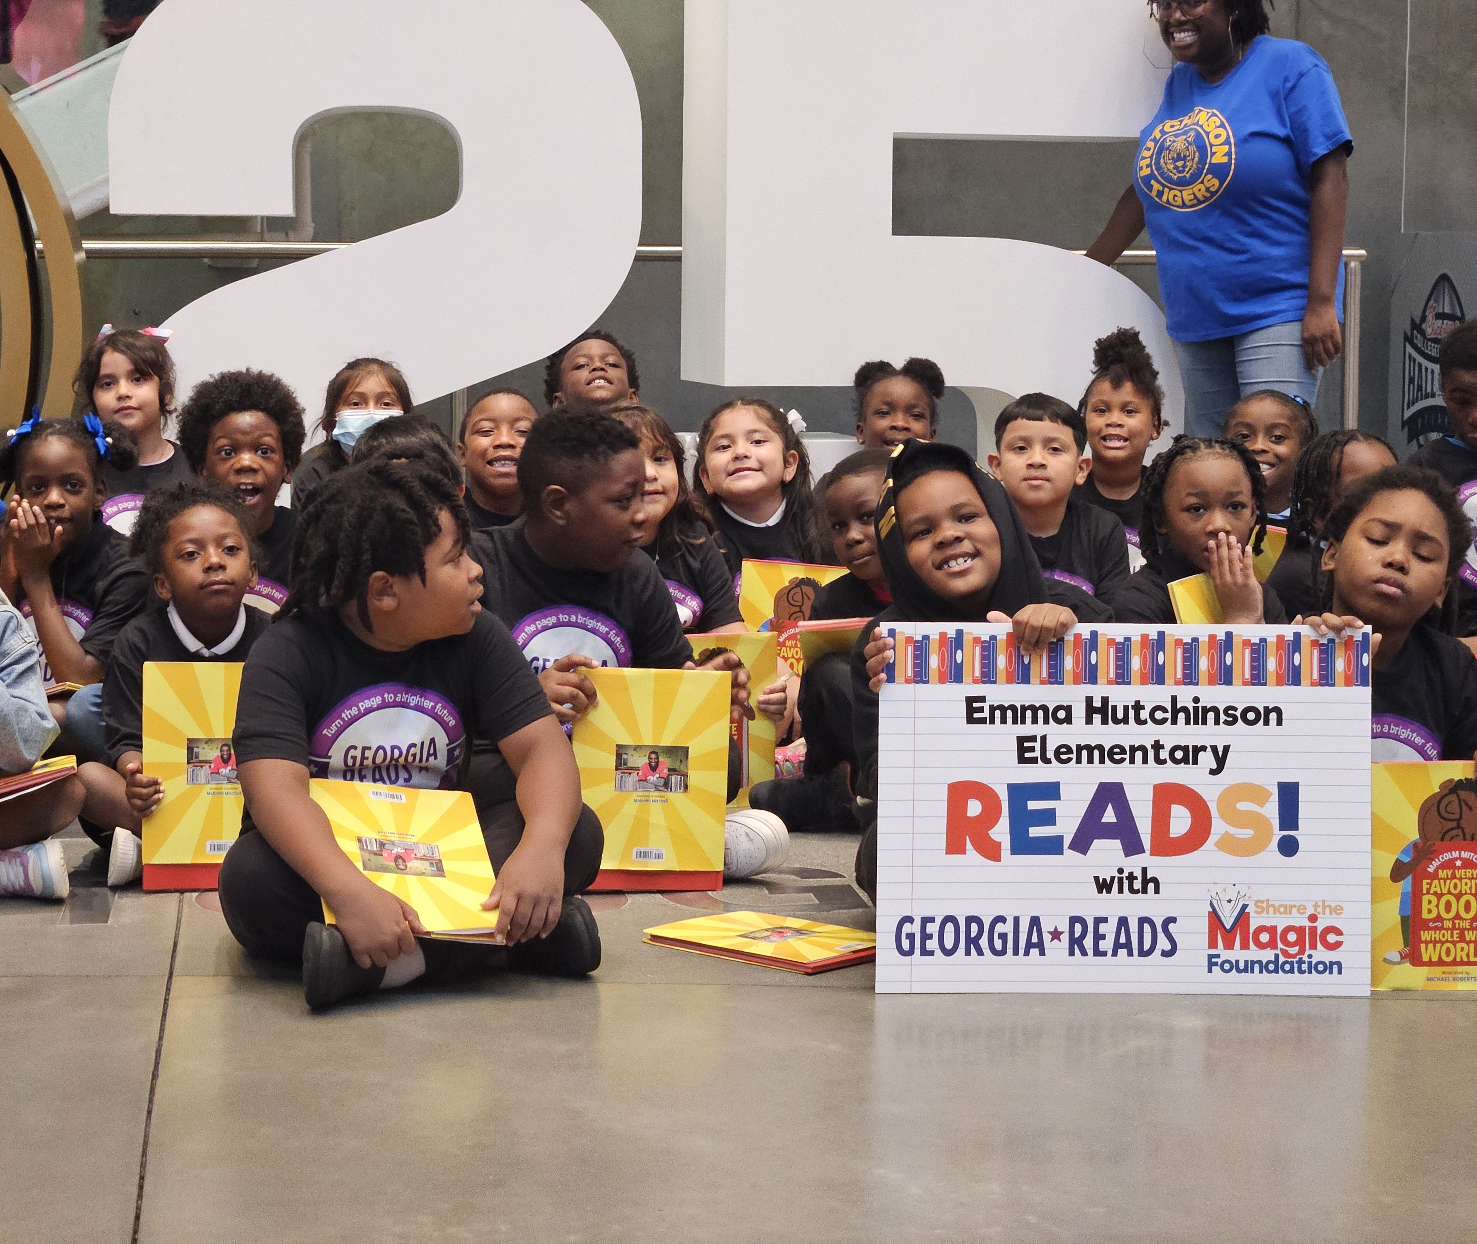
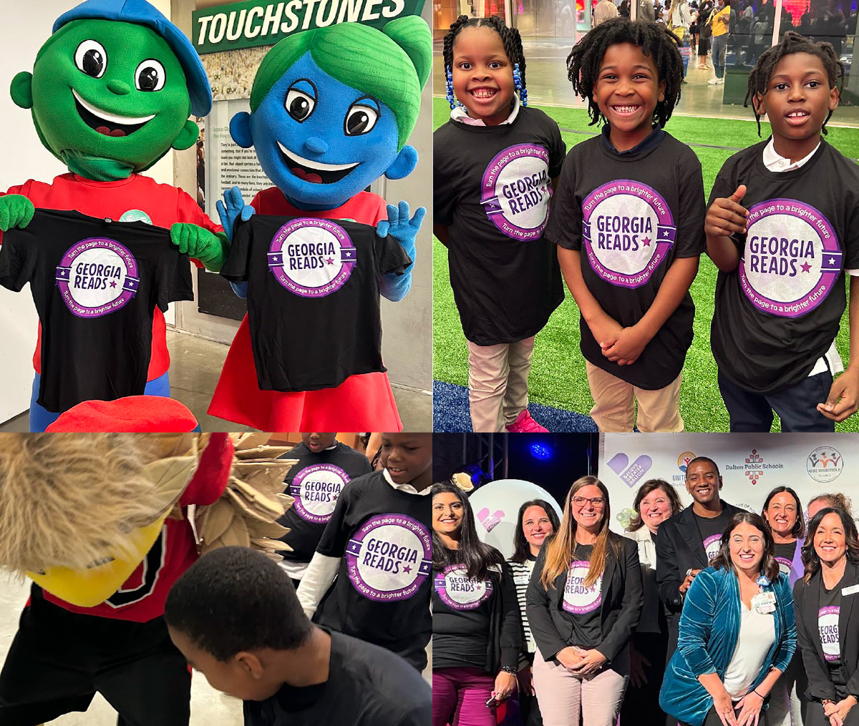
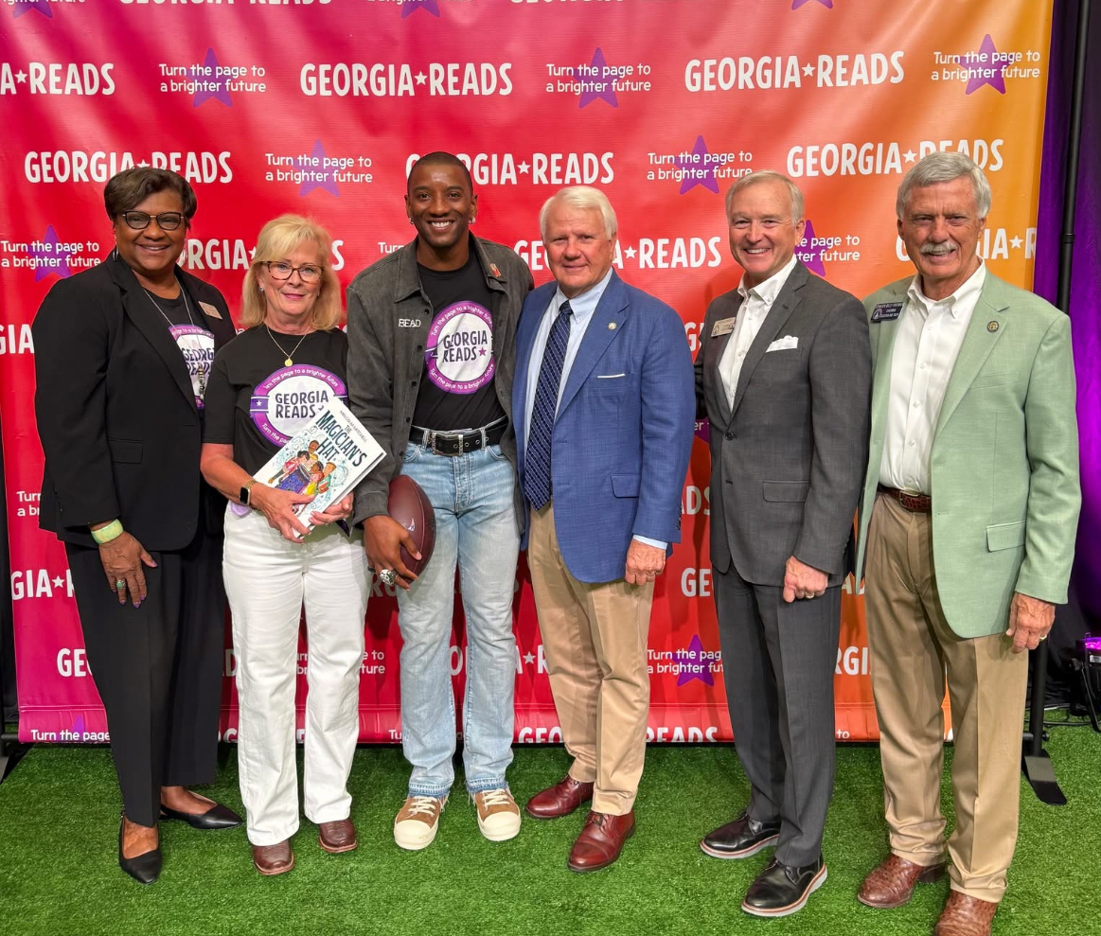


Notes:
These images capture the heart of our work—community engagement, collaboration, and celebration. They remind us that literacy is not just a school initiative; it’s a community movement.

Slide 5
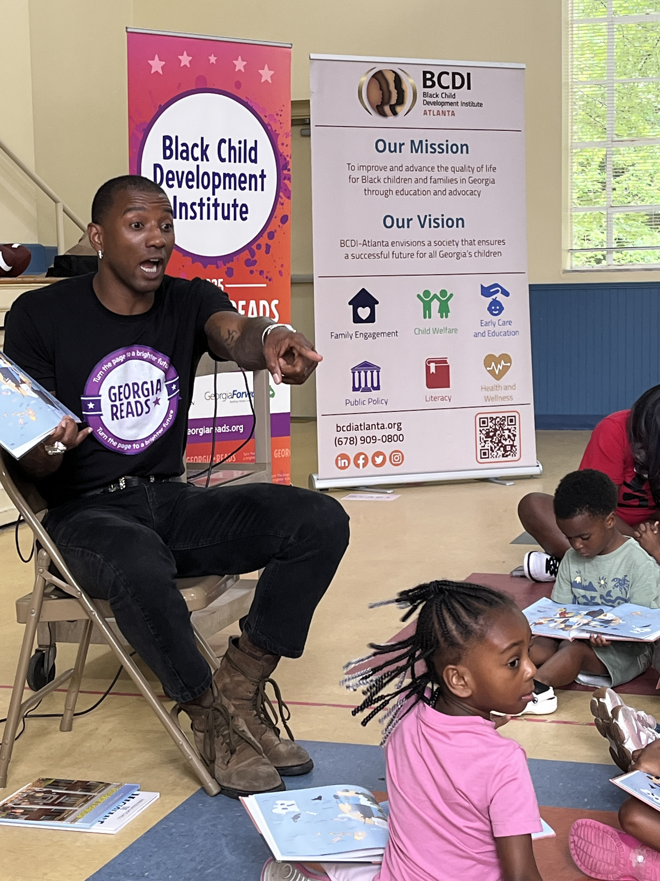
What is the Georgia Reads Community Award?
Ultimately, the award shines a spotlight on communities making a real difference in helping children and adults become strong, confident readers.
Recognizes communities with:
At least two years of meaningful involvement
Two or more collaborating organizations
Commitment to literacy goals
Demonstrated past achievements
Notes:
So, what exactly is this award? It’s designed to spotlight communities making a real difference in literacy. To qualify, your community needs at least two years of meaningful involvement, two or more collaborating organizations, and a proven commitment to literacy goals. This award isn’t about starting from scratch—it’s about recognizing the progress you’ve already made.

Slide 6
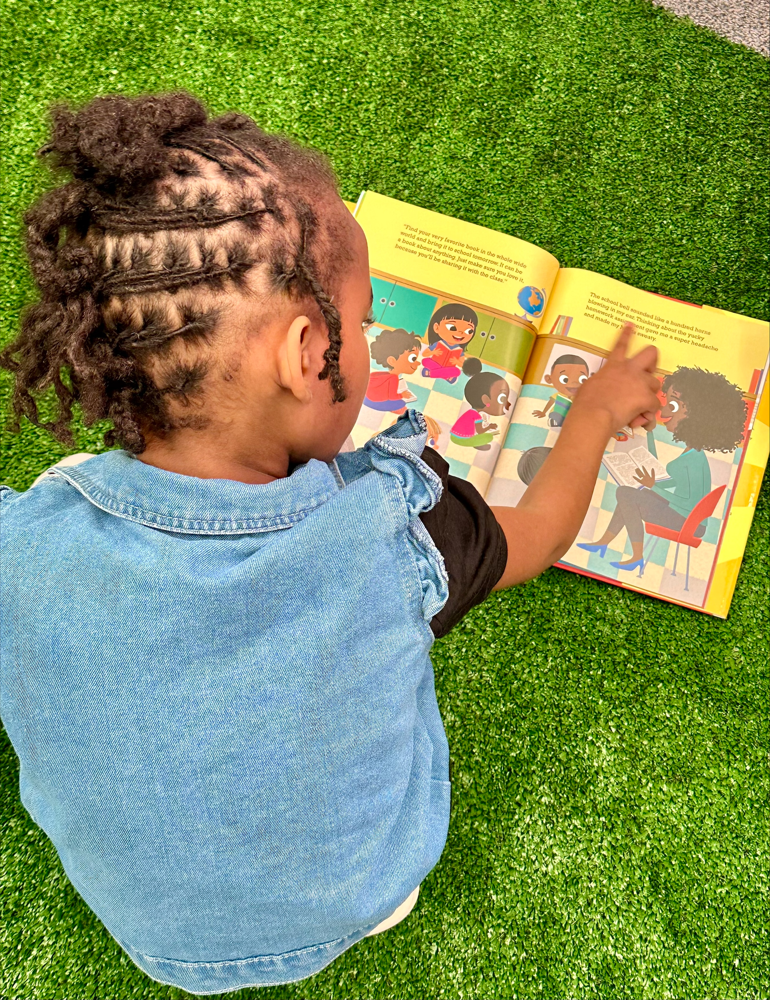
Award Benefits
$20,000 to extend literacy work
Your “best practices” influence the Literacy Council’s recommendations at the state level
Recognition and reading rally visit by Malcolm Mitchell
Up to 1,000 books for students
External evaluation and collaboration opportunities
Notes:
Now, let’s talk benefits. Winning communities receive $20,000 to extend their literacy work, recognition from Malcolm Mitchell with a reading rally, up to 1,000 books for students, and opportunities for external evaluation and collaboration with state leaders. Even more exciting, your work will influence recommendations made by the Literacy Council at the state level, helping move the needle forward across the state. This award is more than funding—it’s a platform to amplify your impact.

Slide 7
Application Sections
Contact Information
Community Need
Goals & Community Activities
Meaningful Partnerships
Data & Analysis
Budget & Justification
  Make sure the budget aligns with your goals and sustainability
Sustainability
Program Overview
  Tells us your story. Make everything “glue” together
Notes:
The application is structured to tell your story. It includes sections on contact information, community need, goals and activities, partnerships, data and analysis, budget, sustainability, and a program overview. Think of these sections as puzzle pieces—they should fit together to create a clear picture of your work.

Slide 8

Rubric Overview
Each section is scored as:
  Excellent (4-5 points)
  Good (2-3 points)
  Needs Improvement (0-1 points)
Final score is calculated using a weighted criteria.
Reviewers will provide written feedback
  Strengths
  Concerns
  Recommendation
Notes:
How will your application be scored? Each section is rated from Needs Improvement to Excellent. Reviewers will provide feedback on strengths and areas for improvement. The key is clarity and alignment with the rubric—make it easy for reviewers to see your impact.

Slide 9
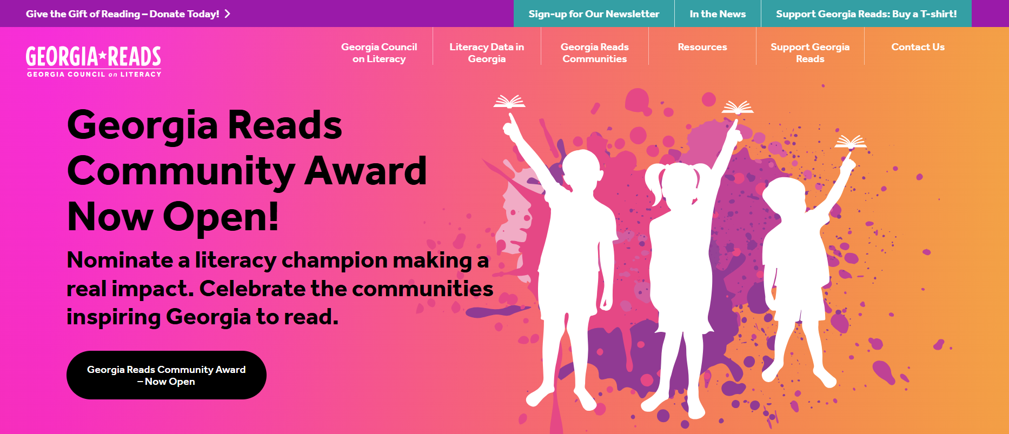
Application Portal
Georgia Reads
Must create a login with an email and password
Portal Features
  Save progress for later
  Character limit reminder
  Email notifications
Notes:
Submitting your application is simple. Use the Georgia Reads portal to create a login, save your progress, and track character limits. You’ll also receive email notifications to keep you on track. The portal is designed to make the process smooth and stress-free.

Slide 10
DATA
Purpose: Show measurable impact of literacy efforts.
What to Include:
  Baseline vs. current data (last 2–5 years).
  Key metrics:
    Literacy/ELA scores (Milestones, Amira ISIP).
    Preschool enrollment rates.
    Event attendance growth.
    Survey results (participant satisfaction, Net Promoter Score).
Use percentages or comparisons for clarity.
Tips:
  Link data directly to activities and goals.
  Avoid overwhelming reviewers—choose 3–5 impactful data points.
Notes:
Data tells your story in numbers. Show measurable impact over the last 2–5 years. Include baseline and current data, focusing on key metrics like literacy scores, preschool enrollment, event attendance, and survey results. Use percentages or comparisons for clarity, and link data directly to your activities and goals. Remember—quality over quantity. Choose 3–5 impactful data points and consider visuals like charts or graphs.

Slide 11
PARTNERS
Definition: Active collaboration where partners contribute time, expertise, or resources—not just endorsements.
Requirements:
  At least 2 years of documented involvement.
  Two or more organizations working together.
What Reviewers Look For:
  Clear roles and responsibilities.
  Evidence of shared planning and accountability.
  Examples of joint activities (e.g., literacy events, family engagement programs).
Tips:
  Show how partners collaborate with each other—not just with the lead applicant.
  Include schools, nonprofits, local government, healthcare, faith-based groups.
  Emphasize sustainability and long-term commitment.
Notes:
Strong partnerships are the backbone of this award. Partners should contribute time, expertise, or resources—not just endorsements. Reviewers want to see clear roles, shared planning, and examples of joint activities. Include schools, nonprofits, local government, and others. If possible, show how partners collaborate with each other—not just with you—and emphasize sustainability for long-term success.

Slide 12
Important Dates
APPLICATION IS OPEN NOW!
Application Deadline: December 5, 2025
Notification: January 2026
Recognition: February/March 2026
Community Visits: Spring 2026
Notes:
Here are the key dates. The application is open now, and the deadline is December 5, 2025. Notifications go out in January, recognition happens in February, and community visits will take place in the spring. Mark your calendars!

Slide 13
Bryttney Bailey
Georgia Council on Literacy
Project Coordinator
Bryttney.bailey@gosa.ga.gov
Ryan Hersh
The Sandra Dunagan Deal Center
Grants Administrator ryan.hersh@gcsu.edu
QUESTIONS?
Notes:
Thank you for joining us today! If you have questions, please reach out to Bryttney Bailey or Ryan Hersh at the emails listed here. We’re here to support you every step of the way. Now, let’s open the floor for your questions.

