Slide 1
Georgia Council on Literacy
Virtual Meeting Slides
October 6, 2026
10:00 AM – 12:00 PM

Slide 2


From Plan to Practice
Community Resources & Assets
An update on the Resource and Conditions Inventory: understanding a community’s resources, assets, and the conditions literacy depends on
Literacy Council update October 6, 2026

Slide 3



Three things carry a plan into practice
WH E R E WE L E FT O FF I N JU L Y
A plan expresses what people intend to accomplish. Three things carry it into practice.
1
2
3
Seeing together
SH A RE D F RA M E W O RK
Acting together
SH A RE D AC T IO N
Learning together
SH A RE D LE A RN IN G
The inventory is a practical way to see together.

Slide 4





The Four Pillars
TH E S H AR E D F R AM E W O R K
IN THE INVENTORY
The conditions that must be in place for literacy to take hold
Language Nutrition
Engagement through language-rich social interactions
Access
Whether what exists actually reaches the people it is for
Positive Learning Climate
Learning environments that are safe, welcoming, and engaging
Teacher Preparation & Effectiveness
Adults equipped for developmentally responsive practice

Slide 5

Access has structure
TH E S H AR E D F R AM E W O R K
IN THE INVENTORY
“Do we have a resource?”
and “Does it actually reach the people it is intended to support?”
are two different questions.
Awareness
Affordable
Accessible
Available
Accommodating
Acceptable
“Access is a challenge” becomes “Which of the Six Keys may need attention, and for whom?”

Slide 6




Types of factors
TH E S H AR E D FR A M E WO R K
PO PU L AT I O N - BA S ED
How children and families are doing
ST R U C T U R A L
What is in place
OP E R AT I ON A L
How the work actually happens
Many factors can be changed, which makes them a place to act.
EX A M P L ES
Maternal health Preterm birth Attendance Housing stability Vision and hearing
Nutrition and food security
EX A M P L ES
Laws, policies, and rules
Funding, payment, and eligibility rules
Standards, preparation, and credentialing requirements
Availability of programs, services, and trained staff
EX A M P L ES
Communication
Working relationships across organizations
Leadership and decision-making
Professional learning and capacity building
Enrollment, referral, and follow-up
IN THE INVENTORY

Slide 7
More than a resource list
TH E R E S O U R C E AN D C O N D I TI O N S I N V E N TO R Y
NOT
A directory of programs
A list shows what exists, but not whether it reaches people or what shapes the conditions.
A SHARED LOOK AT
What a community already has
Resources and assets, including programs, people, places, practices, processes, relationships, and funding. Considered alongside the conditions, the factors shaping them, and how people connect to support.
Looking at these together reveals opportunities a simple list would miss.

Slide 8
How it works: inventory steps
TH E R E S O U R C E AN D C O N D I TI O N S I N V E N TO R Y
It begins with what a community already knows.
Each step adds to a shared picture.
1 Begin with what you already know
2 Consider factors
3 Connect factors to the Four Pillars
4 Look beyond programs
5 Map how people connect to resources
6 Use the Six Keys to examine Access
How do people actually connect to resources, and where does the process break down?

Slide 9
Start with what already exists
TH E R E S O U R C E AN D C O N D I TI O N S I N V E N TO R Y
IN THE INVENTORY
These sources do not need to be labeled literacy work to matter.
WH E R E T O L O O K: E X A M P L E S
WH O H O L D S I T
›
›
›
›
›
›
›
Community Health Needs Assessments
Nonprofit hospitals
Community needs assessments (CSBG)
Community action agencies
Public data sources, e.g., OASIS and County Health Rankings
Public agencies and partners
Local comprehensive and CDBG plans
City and county governments
Strategic plans and other local plans
The organizations that wrote them
Practitioner experience and coalition discussions
Partners already at the table
Family and community perspectives
Families and residents
Reading someone’s assessment tells you something.
Asking them about it starts something.

Slide 10


Map how people connect to resources
TH E R E S O U R C E AN D C O N D I TI O N S I N V E N TO R Y
IN THE INVENTORY
A sample process map: vision and hearing, from screening through follow-up care
1
Screening
›
2
Referral notice
›
3
Scheduling
›
4
Exam and care
›
5
Follow-up
BEFORE: WHERE THE PROCESS BROKE DOWN
Only at school entry
Families may not know why
screening matters
No pediatricians; care can be an
hour away
The cost of an exam, glasses, or
hearing care
The law requires screening, not
follow-up
KEY: Available
KEY: Awareness
KEY: Accessible
KEY: Affordable
FACTOR: Structural
Mapping shows where the process breaks down.

Slide 11


Map how people connect to resources
TH E R E S O U R C E AN D C O N D I TI O N S I N V E N TO R Y
IN THE INVENTORY
How one Georgia community addressed vision and hearing, from screening through follow-up care
1
Screening
›
2
Referral notice
›
3
Scheduling
›
4
Exam and care
›
5
Follow-up
AFTER: THE LINKS PARTNERS BUILT
Grades K–3 and 8, by trained school
nurses
Letters explain why screening
matters, and the school provides referrals
With permission, school staff
contact local specialists
Local optometrists and audiologists
agreed to serve families in need
School staff coordinate with
families and specialists
Available, Accessible
Awareness
Accessible
Affordable
Operational
Mapping shows where the process breaks down, so partners know where to act.

Slide 12
From a factor to a change in practice
A S E C O N D E X AM P L E
Language development across the continuum
Language development is continuous. How educators are prepared and supported is not.
BIRTH TO FIVE
Child care, Head Start, and Pre-K educators Supported through CCR&Rs
K– 3
Kindergarten through third grade teachers Supported through RESAs
The approach: early learning programs and the school district adopted a shared developmental progression lens, so educators in both settings notice how all children are communicating and scaffold from there.
Connects to Unified Literacy Plans · Regional Literacy Leadership Coach responsibilities · GaPSC Rule 505-3-.03 · Georgia Literacy Coach Competency Framework · GELDS · Georgia K–12 English Language Arts Standards
Vision 2030 Goal 1.1 · Priority 3
Part of Vision 2030 moves from plan to practice.
Illustrative example.

Slide 13
The same questions work at other levels
TH E R E S O U R C E AN D C O N D I TI O N S I N V E N TO R Y
IN A COMMUNITY
What is in place here, and how do families connect to it?
ACROSS A REGION
What patterns appear across the communities served?
ACROSS GEORGIA
What is in place statewide, and how does it reach communities?
State agencies and statewide partners
e.g., community collaboratives, schools, early learning, families, healthcare, libraries, local government
e.g., regional partners that serve many communities
Communities see things state partners cannot easily see; state partners see patterns no single community can see.

Slide 14
From Plan to Practice
Vision 2030 gives Georgia a destination.
The Four Pillars provide shared language for the conditions literacy depends on.
The tools help communities see those conditions, act on them, and learn from them.
When communities and state partners work toward the same conditions, with a shared understanding and learning together as they go,
a plan becomes practice.

Slide 15


Georgia Southern University Literacy Center
Literacy Council Update
October 6, 2026

Slide 16
From Literacy Science
to Classroom Results
Partnership driven implementation with measurement of teacher practice and student outcomes

Slide 17








Purpose
Establish a collaborative infrastructure for supporting evidence-based literacy instruction across Georgia.
Demonstration Sites for Effective Literacy and Pre-Service Teacher Preparation
Professional Learning for Literacy Coaches
Measure Educator and Leader competency and student outcomes

Slide 18

Purpose
Establish a collaborative infrastructure for supporting evidence-based literacy instruction across Georgia.
Demonstration Sites for Effective Literacy and Pre-Service Teacher Preparation
Partners with pre-service teacher education programs at four USG institutions.
Strengthens alignment between university curricula and district needs to better prepare classroom-ready teachers with a strong foundation in evidence-based literacy instruction.
Establishes up to eight demonstration sites in rural and urban communities across Georgia.
Pairs sites with university partners to serve as visible, data-informed proof points for legislators and district leaders.

Slide 19
Collaborative Partnership
Demonstration Districts will provide a replicable model to scale transformative professional development, leading to excellence in literacy instruction
Teacher preparation programs will coordinate to improve preservice literacy training
Flexibility to the unique needs of your partner schools
Collaboration with other University partners for pre-service teacher hub
Focus on research aligned with faculty interest

Slide 20
Purpose
Establish a collaborative infrastructure for supporting evidence-based literacy instruction across Georgia.
Professional Learning for Literacy Coaches
Collaborates with regional literacy specialists to deliver accessible, community-embedded professional development.
Delivers continuous training tailored to specific gaps identified in coaching competency assessments and classroom student data.
Hones coaching skills through direct analysis of real classroom lessons, providing feedback targeted toward student needs.
Deepens coaches’ diagnostic skills and expertise, reliably improving the quality of teacher instruction in their schools.

Slide 21
Purpose
Establish a collaborative infrastructure for supporting evidence-based literacy instruction across Georgia.
Measure Educator and Leader competency and student outcomes
Measures the knowledge, skills, and instructional capabilities of teachers and coaches before and after training.
Connects assessment criteria directly to the Science of Reading and Georgia’s Coaching Competencies.
Provides the necessary metrics to prove state investments in literacy coaching are yielding measurable improvements in educator competency and student outcomes.

Slide 22
Expected Outcomes
1
All school-based literacy coaches will possess the knowledge, skills, and capabilities to support and coach K-3 educators in the science of Reading
2
Demonstration Schools/Districts will provide a replicable model to scale transformative professional development, leading to excellence in literacy instruction
3
Teacher preparation programs will coordinate to improve preservice literacy training

Slide 23
Our Progress
Committee Meetings
Re-evaluate teachers and students
Request for Proposals Posted
Demonstration Sites
Vendor Identification
Pre-Service Teacher

Slide 24
GSULC Committees
Steering Committee | Executive Committee | Research Committee | Implementation Committee | Pre-Service Committee
Met August 27, 2026 Key stakeholders and partners Provides feedback to GSULC leadership | Monthly Meetings Deans of Demonstration Sites Sets direction and develops school partnerships | Monthly Meetings Sets research agenda and determines measures | Meets bi-weekly Maintains partnerships at demonstration sites Develops research protocols and executes research Provides oversight and support at demonstration sites | Meets bi-weekly Develops and executes research with pre-service teachers Collaboration between institutions on educator preparation
Notes:
Justification as to why you selected these schools/districts

Slide 25

Demonstration Sites
School sites identified
Responsible research board approval is underway
Professional development and initial data collection to begin in November and continue through May 2027

Slide 26
Vendor Identification Timeline
August 3
September 3
September 9 - 23
Late September
September 29-October 10
RFP Opens
RFP Closes
Review Committee Meets
Proposal Review Window
Contract Negotiations
Score Reconciliation Period
Reconciliation meeting
Re-evaluate teachers and students

Slide 27

Pre-Service Teacher Collaboration
Pre-Service teacher experiences with literacy assessments in Demonstration Sites
Development of a common literacy tool for Pre-Service Teachers
Notes:
Justification as to why you selected these schools/districts

Slide 28
Timeline
August - September
October - November
December - January
February - April
May - June
Preservice Teacher Preparation and Demonstration Sites
Ongoing Coaching
Sites Identified
Initial Measures & Professional Development
Final Measures & Analysis
Professional Learning for Literacy Coaches
Professional Development and Continuous Training for all school-based literacy coaches
Evaluations Measure Educator Capabilities
Development of measure
Administration of measure

Slide 29
Questions?

Slide 30
Thank you!
Caitlin Criss, ccriss@georgiasouthern.edu

Slide 31

Literacy Coaching Endorsement
Preparation Rule
Georgia Council on Literacy Virtual Meeting
October 6, 2026
Dr. Rebecca Pennington
Lead Literacy Specialist
Georgia Professional Standards Commission

Slide 32
Literacy Coaching Endorsement
Preparation Rule
Required by HB 1193 Georgia Early Literacy Act of 2026
Rule components specify:
Who is eligible to enroll in the endorsement,
The knowledge they must possess to begin the program,
The knowledge and skills they must demonstrate to successfully complete the program, and
How they will be assessed.

Slide 33
Literacy Coaching Endorsement
Preparation Rule
Rule was drafted by the Literacy Coaching Endorsement Task Force, comprised of a representative sample of subject matter experts.
Content of the standards drawn from state-approved standards that cover four domains:
  Creating and Fostering a Culture of Collaborative Literacy Leadership
  Knowledge and Application of Assessment to Inform Literacy Instruction
  Knowledge and Application of Literacy Development and Instruction
  Development and Implementation of Literacy-Focused Professional Learning

Slide 34
Literacy Coaching Endorsement
Preparation Rule
Knowledge and skills will be demonstrated and assessed during structured, job-embedded clinical experiences with experienced literacy coaches serving as mentors.
A standardized assessment is being developed in collaboration with ES Pearson.
  Used as a competency-based pre-assessment for those with prior knowledge and experience
  Used as a competency-based post-assessment at program completion

Slide 35
Literacy Coaching Endorsement
Preparation Rule: Current Status
New Preparation Rule 505-3-.115 Literacy Coaching Endorsement Program
Target Dates:
  October 8, 2026: Official rule-making process will be initiated by the Commission.
  December 2026: Adopted by the Commission
  January 1, 2027: Rule becomes effective
  Spring of 2027: EPPs develop programs based on rule
  Fall of 2027: Programs reviewed
  Summer of 2028: EPPs offer approved programs and enroll candidates

Slide 36



1
Richard Woods, Georgia’s School Superintendent | Georgia Department of Education | Preparing ALL Students for Life

Slide 37
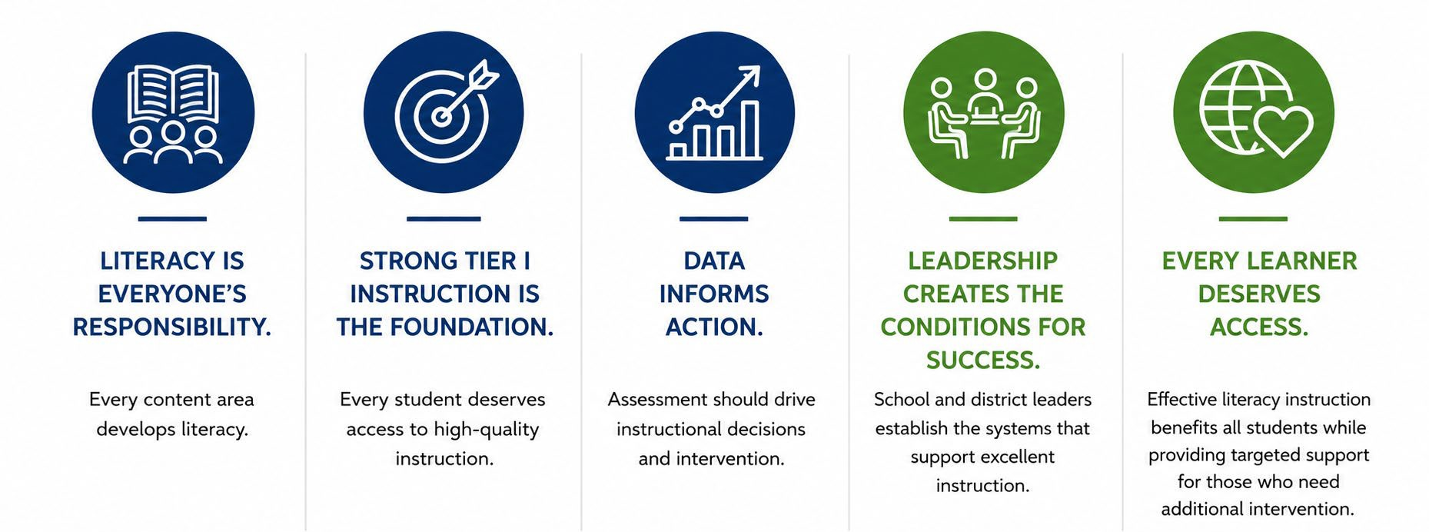

Our Beliefs

Slide 38
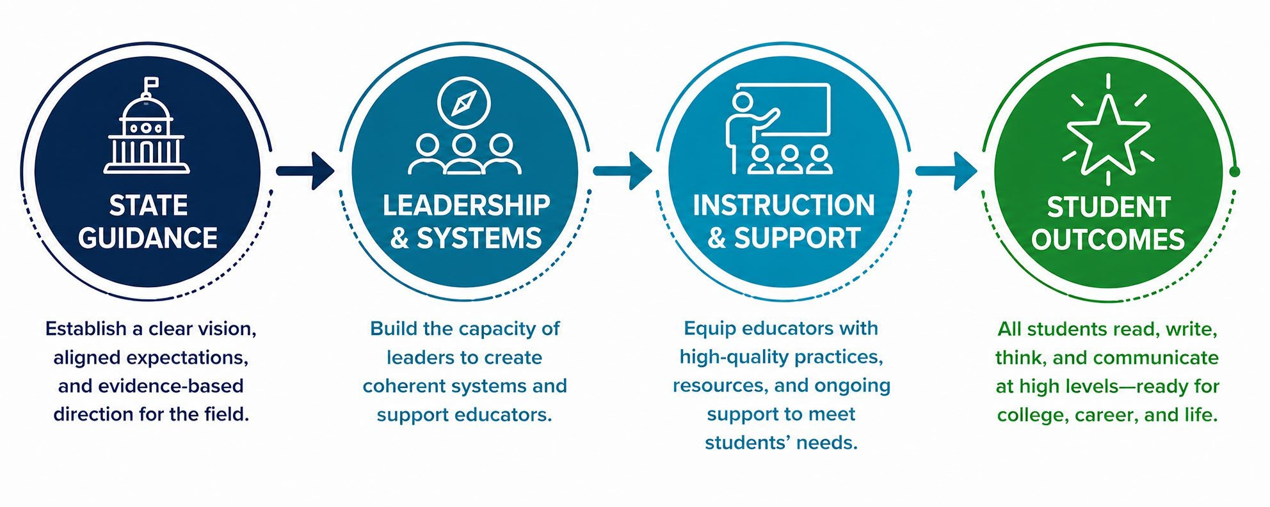
Why Adolescent Literacy – Why Now?
Strengthening Literacy Systems to Improve Student Outcomes

Slide 39
Three Levels of Adolescent Literacy
Content Area Literacy
Basic Literacy
Disciplinary Literacy
4th
Kindergarten 6th Grade
Adapted from Ippolito, J., Dobbs, C. L., & Charner-Laird, M. (2019)
12th Grade
4
Richard Woods, Georgia’s School Superintendent | Georgia Department of Education | Preparing ALL Students for Life

Slide 40

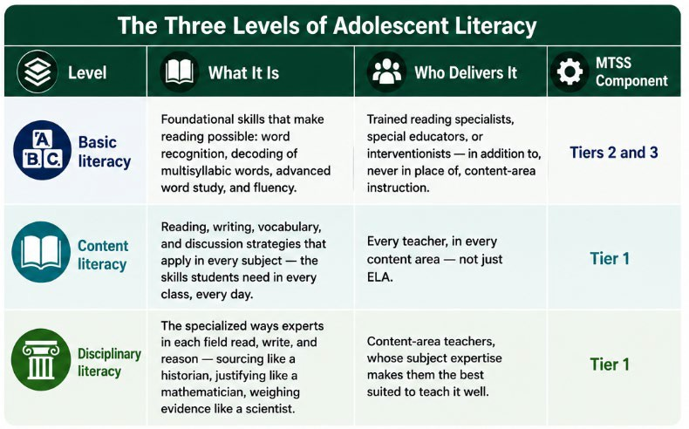
A Shared Framework
Creating a common language for adolescent literacy leaders and educators.
Why a Shared Framework?
Build a shared understanding of adolescent literacy.
Clarify the unique purpose of each level.
Align instruction, intervention, and professional learning.
Make informed decisions about student support.
Strengthen collaboration across schools and content areas.
Richard Woods, Georgia’s School Superintendent | Georgia Department of Education | Preparing ALL Students for Life

Slide 41
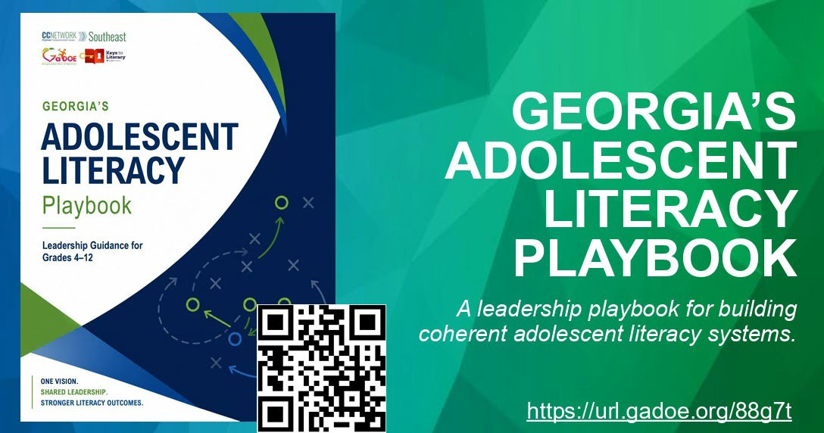
Richard Woods, Georgia’s School Superintendent | Georgia Department of Education | Preparing ALL Students for Life

Slide 42
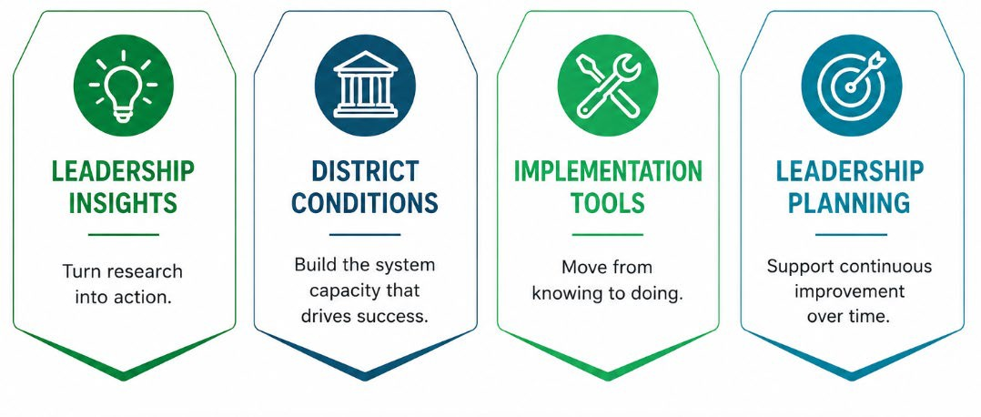
Signature Features of the Playbook
Four design features to support leaders.

Slide 43
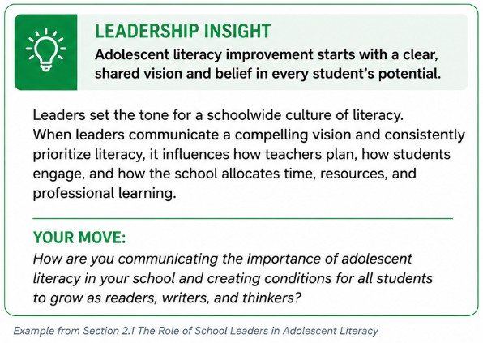
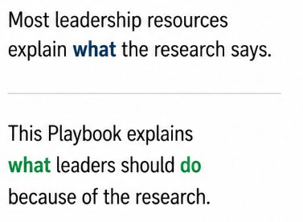

Leadership Insights
Turning research into leadership action.
WHY WE INCLUDED IT

Slide 44
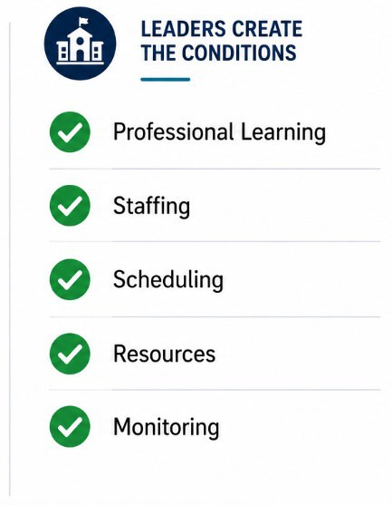
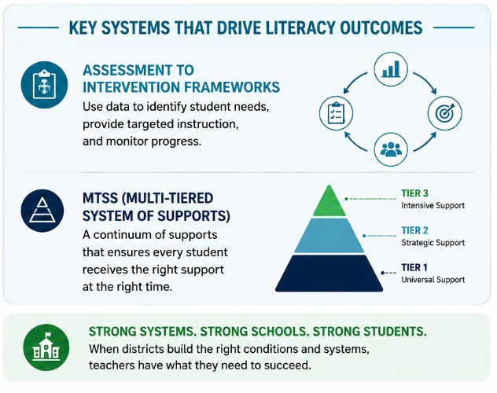
District Conditions for Success
Building the system supports that drive literacy outcomes.

Slide 45
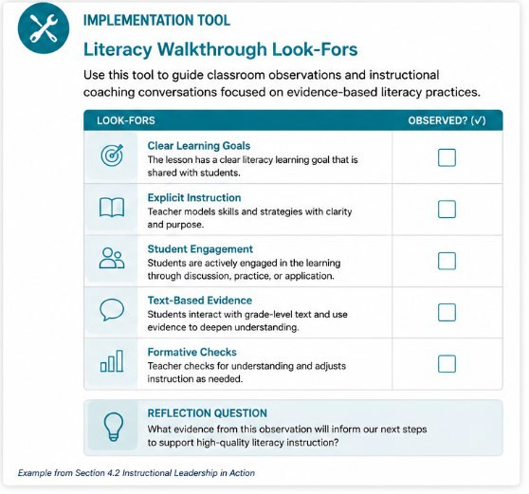
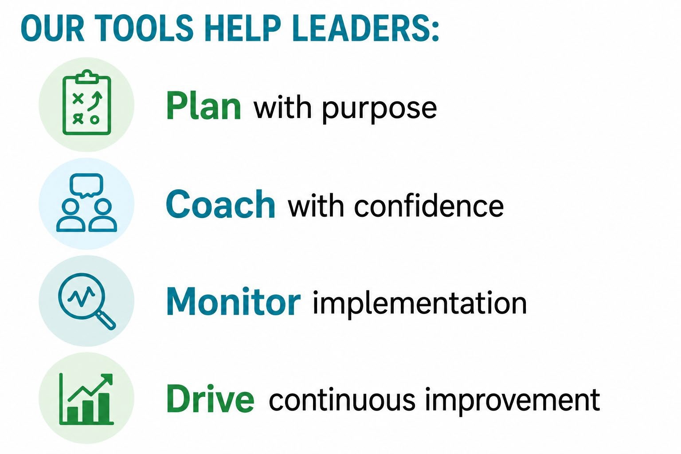
Practical Implementation Tools
Tools to help leaders turn ideas into action.

Slide 46
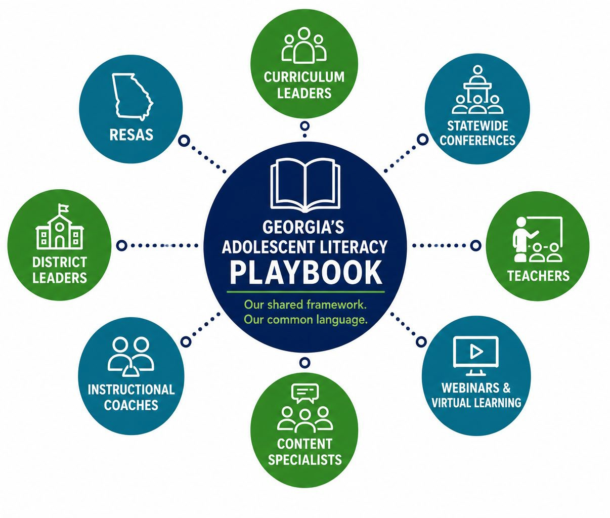
More Than a Resource
An anchor for statewide professional learning and leadership development.
We will use it to:
Build a common language across Georgia
Develop leaders and teachers together
Connect professional learning across divisions
Support coherent implementation statewide

Slide 47
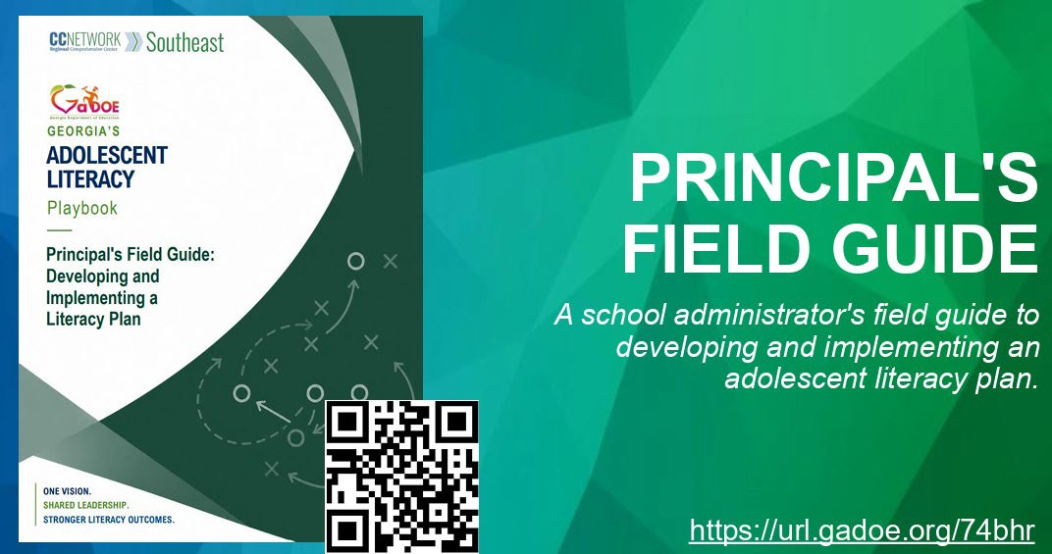

Slide 48
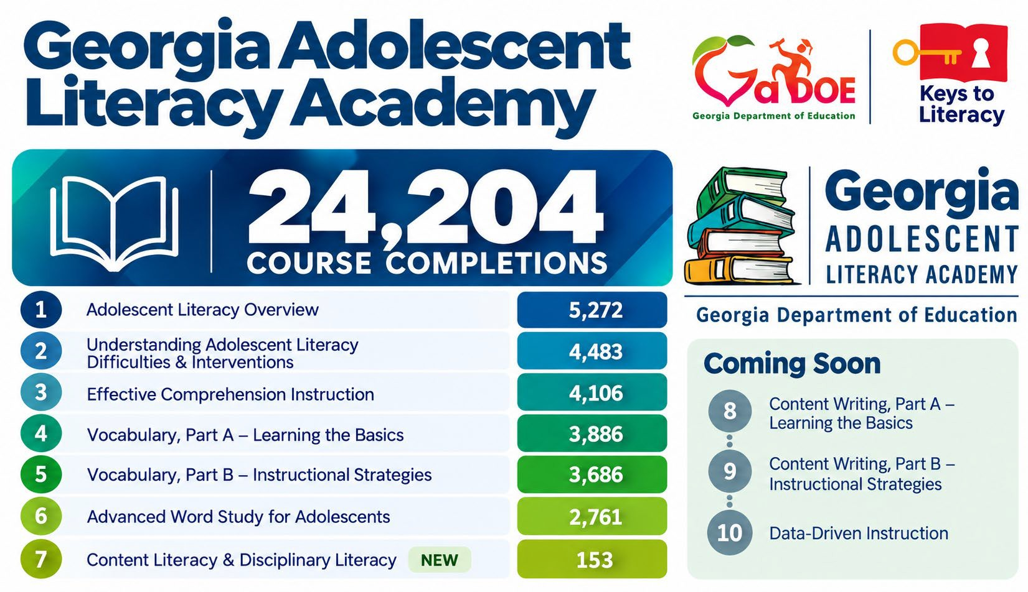

Slide 49


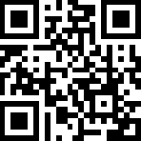
LEADING ADOLESCENT LITERACY
Ep. 901: Basic Literacy Ep. 902: Content Literacy
FROM THE FIELD
Marietta City Schools
Scan to access
https://www.gpb.org/education/classroom-conversations
14
Richard Woods, Georgia’s School Superintendent | Georgia Department of Education | Preparing ALL Students for Life

Slide 50
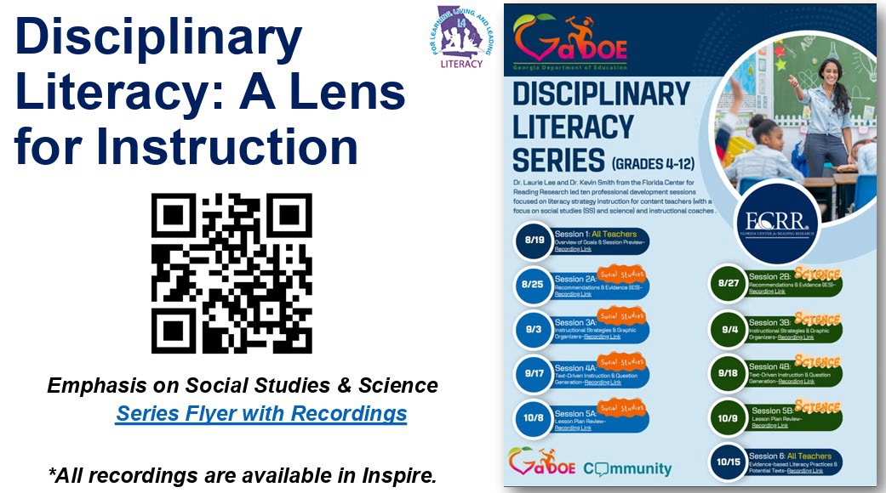
Richard Woods, Georgia’s School Superintendent | Georgia Department of Education | Preparing ALL Students for Life

Slide 51

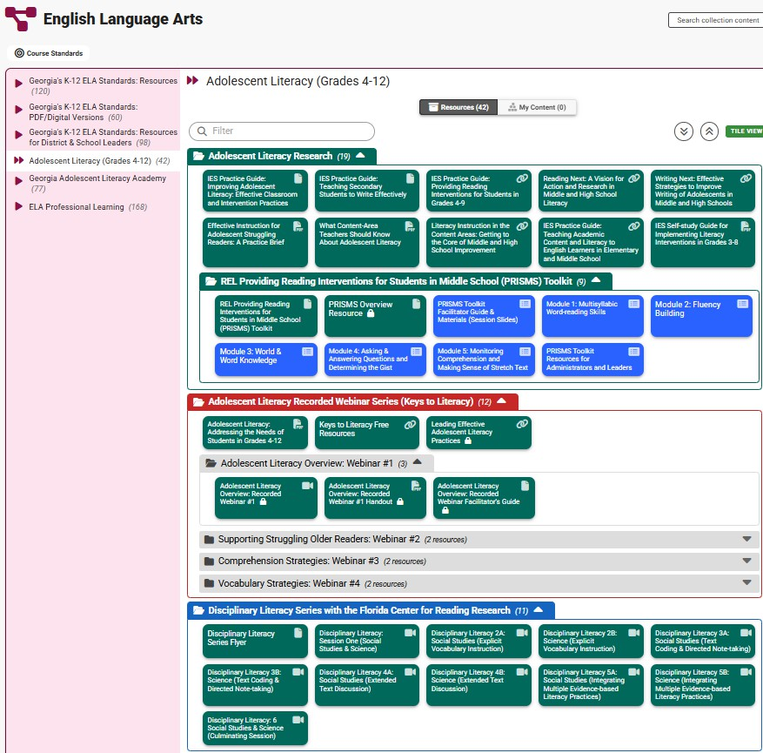

Adolescent Literacy Resource Repository
https://inspire.gadoe.org/collection/C00029/9320

Slide 52


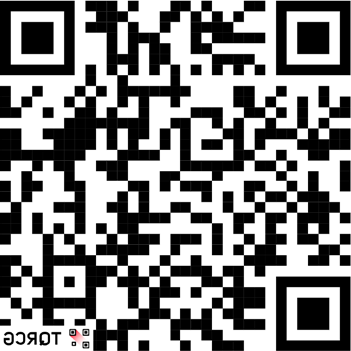

GaDOE Diagnostic Assessment
Toolkits

Slide 53


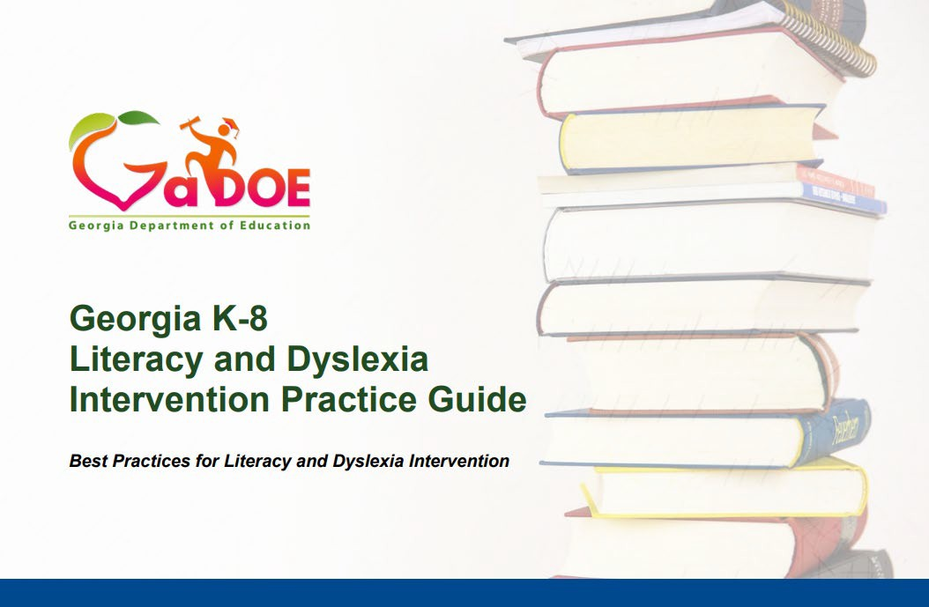
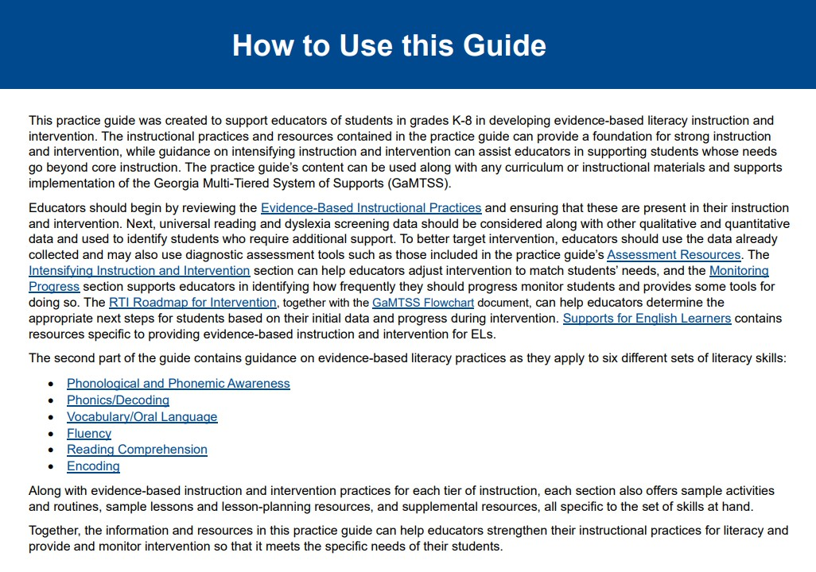

K-8 Literacy & Dyslexia Intervention Practice Guide
https://url.gadoe.org/4pynd

Slide 54
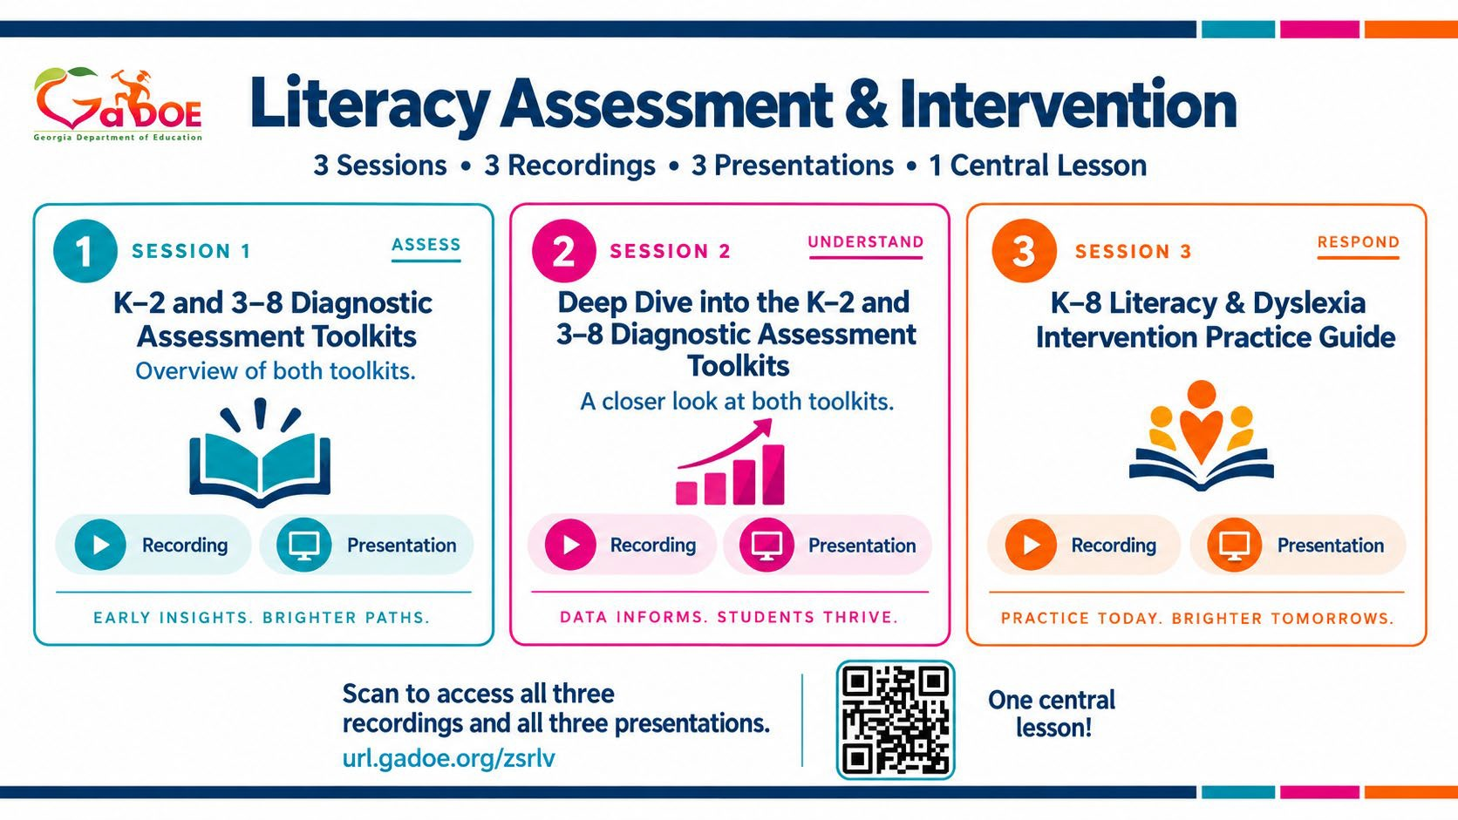
Richard Woods, Georgia’s School Superintendent | Georgia Department of Education | Preparing ALL Students for Life

Slide 55




Literacy Shorts
Short videos to support literacy instruction
Verbal Reasoning Reading Rope
Phonological Awareness
Language Structure
Sight Recognition
Six Elements of Word Recognition
Literacy Knowledge
Vocabulary
Clarifying Conversation: Sight Word Vocabulary
View the full Literacy Shorts series.
20
Richard Woods, Georgia’s School Superintendent | Georgia Department of Education | Preparing ALL Students for Life

Slide 56
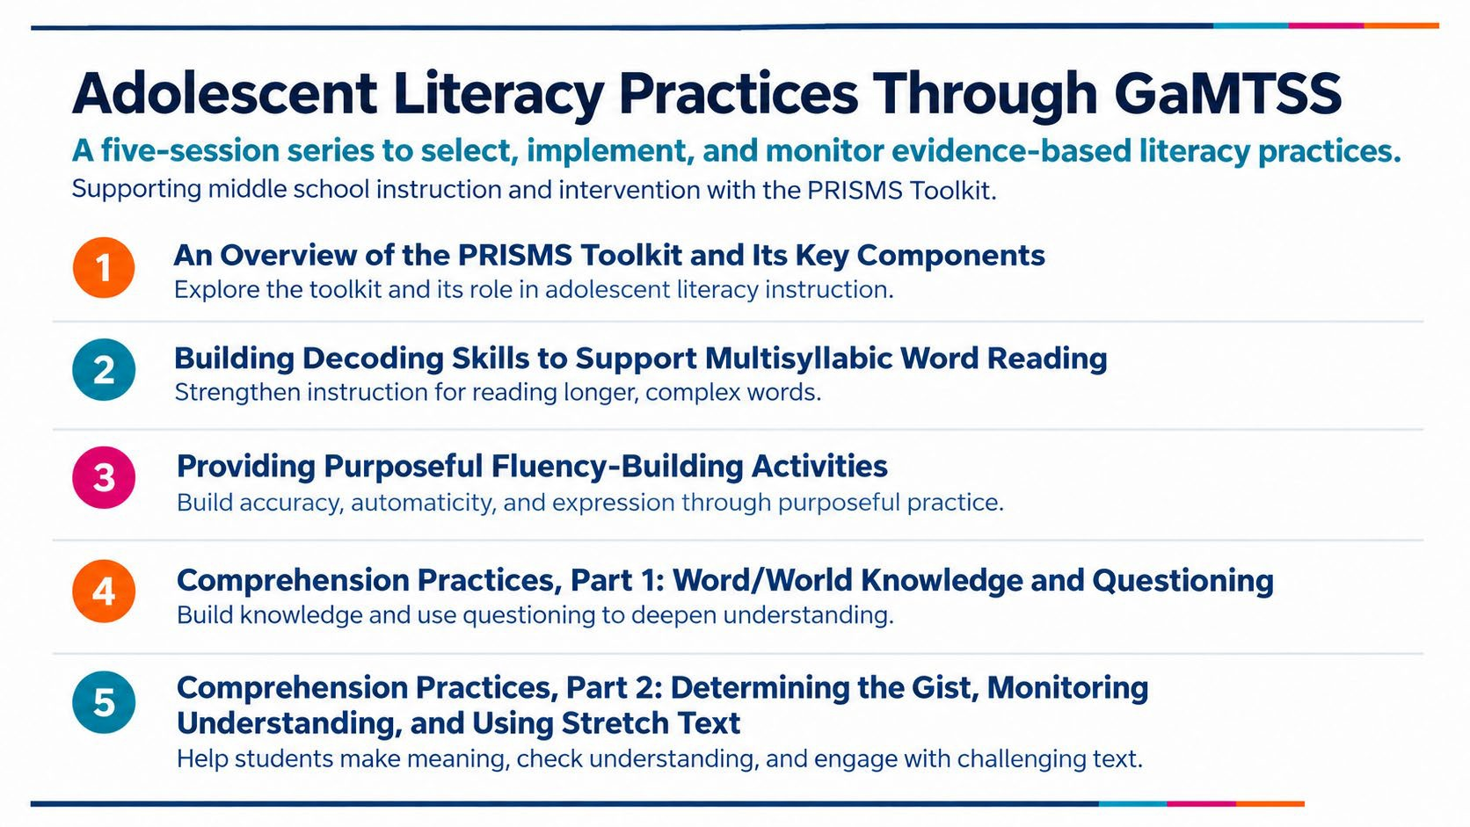
Register here: Select, Implement, and Monitor Adolescent Literacy Practices Through GaMTSS - GaDOE Community

Slide 57
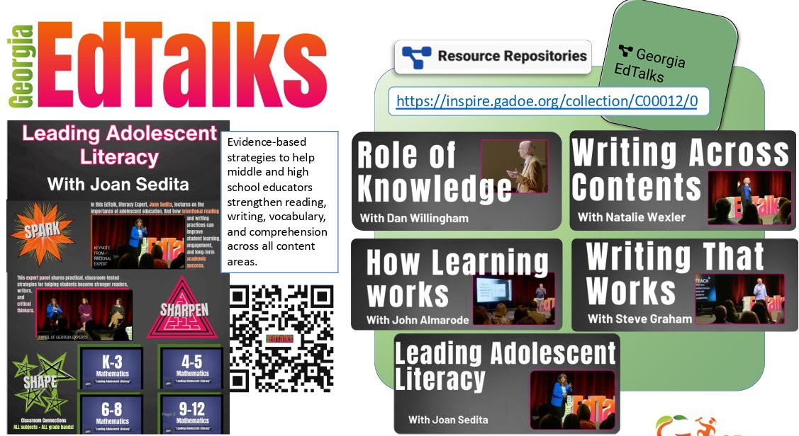

Slide 58


Today’s Slides
https://url.gadoe.org/2dcnr

Slide 59
THANK YOU
Social Media: @GeorgiaDeptofEd
YouTube: @GeorgiaDepartmentofEducation
Web: gadoe.org

