Slide 1

Engineering a Unified Foundation for Georgia Literacy
An Overview of the Unified Literacy Coaching Project
Presented by
Dr. Lindee Morgan

Slide 2

Unified Literacy Coaching Project
The Unified Literacy Coaching Project (ULCP), led by the
Sandra Dunagan Deal Center for Early Language and Literacy,
followed a rigorous, collaborative process to create a
comprehensive framework for literacy coaching in Georgia.

Slide 3

Project Components
Landscape Analysis
Domains, Standards & Competencies
Cohesive Evaluation System Components
Georgia Literacy Coach Competency Framework
Notes:
[Animated to focus on #2 as the topic; CLICK to emphasize and make the other objectives disappear]
There were three key project components. Today’s presentation will review the Domains, Standards, & Competencies created as part of the project.
These Domains, Standards, and Competencies are Georgia’s Literacy Coach Competency Framework.

Slide 4

Competency Task Force
Amy Lingo - Dean, Georgia Southern University College of Education
Gary Bingham – Director, The Urban Child Study Center, Georgia State University
Lindee Morgan – Executive Director, Deal Center, Georgia College and State University
Michelle Palmer – RESA Network Lead, Let’s Read Georgia
Nik Philmon – State Structured Literacy Coach Coordinator, GaDOE
Julillian Davis – District Curriculum & PD Specialist – Kendezi School
Amy Denty – Director of Literacy, GaDOE
Shakia Bruce – Growing Readers Specialist, Growing Readers; RESA Metro
Laurie Allison – Executive Director, Let’s Read Georgia; RESA Northeast
Ann Marie Johnson – Early Literacy Coordinator, Growing Readers; RESA West
Stacey Lutz – State Literacy Coaching Coordinator, GOSA
Paige Pullen – Owner, Literacy Mindset
“CTF”
Notes:
The Deal Center Team collaborated with a multi-disciplinary group, the Competency Task Force, or “CTF” to develop the Domains, Standards, and Competencies.
Collectively, the group represented a variety of stakeholder interests, areas of expertise, types of experience, etc.
Paige Pullen facilitated task force meetings

Slide 5
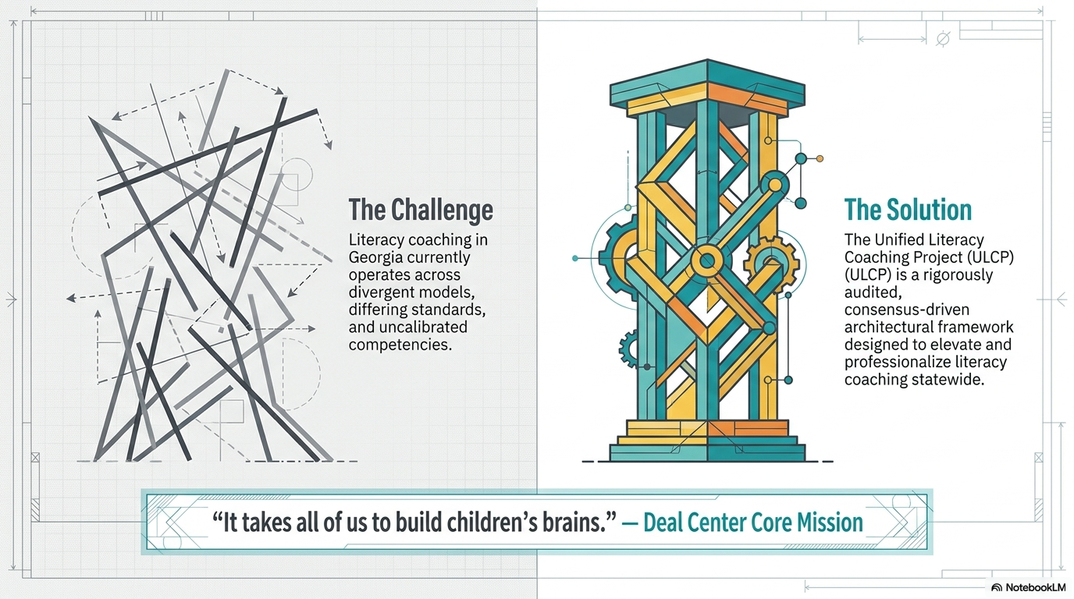
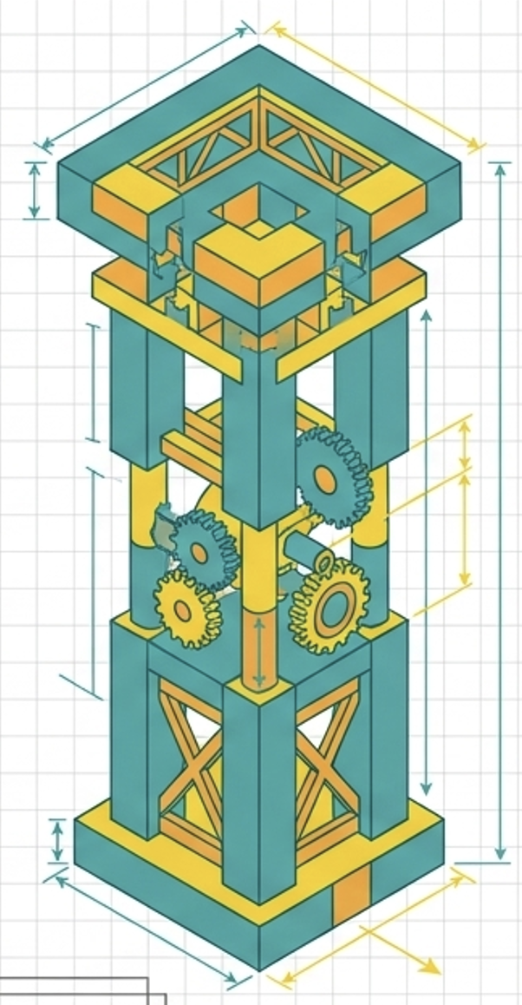
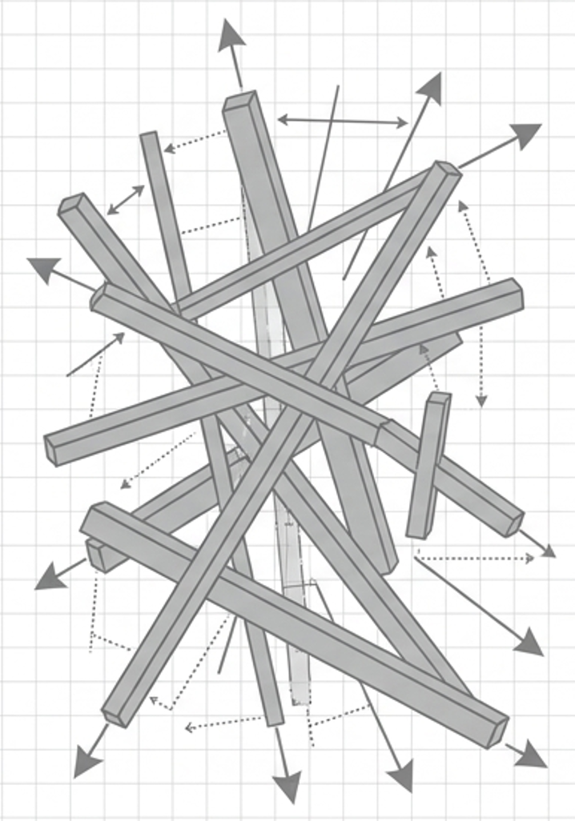
The Challenge
Literacy Coaching systems in Georgia operate independently without a shared framework—often with very different methods, expectations, and processes.
v
Finding A Solution
The UCLP produced a set of Domains, Standards, and Competencies that comprise a consensus-driven framework to help support, elevate, and unite the work of literacy coaches statewide.
“It takes all of us to build children’s reading brains.” –The Deal Center Team
Notes:
[Animated to show ”The Challenge” first. CLICK to show “The Solution” and quote]
The project is contextualized within a setting that presents a challenge: literacy coaching systems in Georgia operate independently without a shared framework, methods, or processes.
The Domains, Standards, and Competencies developed within the Unified Literacy Coaching Project a one solution to this challenge.
These Domains, Standards, and Competencies represent the core knowledge, skills, and abilities that all literacy coaches need to be effective. Together, they comprise a consensus-driven framework to SUPPORT and ELEVATE the work of literacy coaches.
Per the new HB 1193 legislation, the new literacy coach endorsement is being created. The endorsement will serve to recognize literacy coaches who possess expertise in the standards and competencies in a systematic and standardized way. In addition, the endorsement requirements serve as a roadmap for professional development to prepare literacy coaches for the endorsement process.
The result helps move us toward a more standardized system of literacy coaching across Georgia.

Slide 6
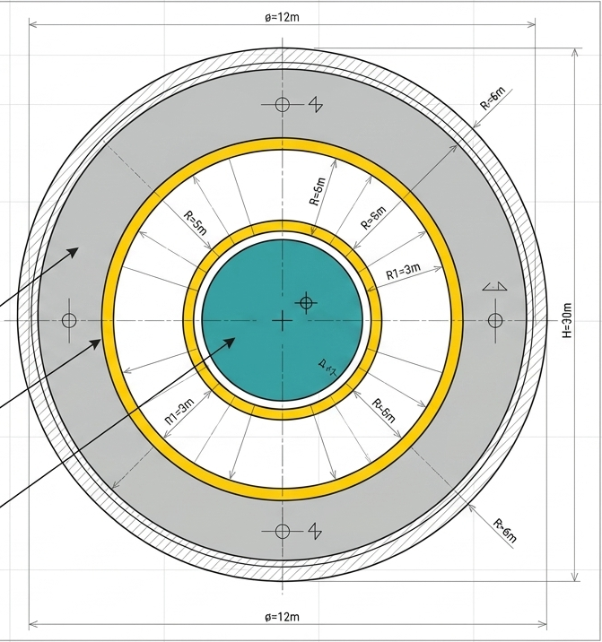
Supportive Structure
Literacy Coaching Domains, Standards, & Competencies are the foundation for effective literacy coaching that school systems and educators can rely on for support.
v
4 Literacy Coaching Domains
Broad, overarching categories of practice
Standards
Specific expectations nested within each domain
Competencies
Granular, measurable, specific actions or abilities

Slide 7
Completion Timeline
Domains
Standards
Competencies
Preamble & Glossary
October November-December January-February March
Notes:
[Talk about the timeline for completing the parts, which was much faster than typical—often around 2 years]
NOTE: Not sure about the location of the timeline in the slide deck. Could be moved elsewhere

Slide 8
“Stress Test” Process
Intensive analysis to determine stability, durability, and ”breaking points”
Notes:
As the Competency Task Force developed the Domains, Standards, and Competencies, they used a “Stress Test” process. A stress test is a form of intensive analysis used to determine the stability, durability, and breaking points of something. We wanted to make sure that the Domains, Standards, and Competencies could withstand stressors that could undermine their strength and durability. For example, we elected to not use “jargon” that might fall out of vogue and instead opted to use clear descriptors that could stand the test of time.

Slide 9
“Stress Test” Process
Phase 1:
Review existing examples (e.g., from other states)
Phase 2:
Create draft informed by stakeholder input and Georgia goals, standards, and priorities
Phase 3:
Gather feedback, then revise & refine; remove redundancy, ensure alignment/completeness. and build consensus
Phase 4:
Finalization and
approval
Notes:
[Animated to go through phases; CLICK for each phase]
The phases we used to develop each deliverable were as follows:
[CLICK] Phase 1: Review existing examples (e.g., from other states including Alabama, Florida, and Louisiana)
[CLICK] Phase 2: Create a draft informed by stakeholder input (usually the CTF) and Georgia’s goals, standards, and priorities
[CLICK] Phase 3: Gather feedback, then revise and refine, removing redundancy, ensuing alignment/completeness, and building consensus
[CLICK] Phase 4: Finalization and approval, which always involved a final consensus vote.

Slide 10
“Stress Test” Process
Phase 1:
Review existing examples (e.g., from other states)
Phase 2:
Create draft informed by stakeholder input and Georgia goals, standards, and priorities
Phase 3:
Gather feedback, then revise & refine; remove redundancy, ensure alignment/completeness. and build consensus
Phase 4:
Finalization and
approval
Notes:
[Animated to show how phase 3 was sometimes repeated; CLICK to show]
It was typical for the team to go through more than one ”round” of Phase 3 when developing each of the components—domains, standards, competencies, preamble, and glossary.

Slide 11
Phase 3 ‘Rounds’
Gather Feedback
Phase 3:
Gather feedback, then revise & refine; remove redundancy, ensure alignment/completeness. and build consensus
Consensus
Reached
Review
Revise
Refine
Notes:
[NOTE: focus on these rounds as a key aspect of the collaborative process]
Each Phase 3 ‘round’ included collaborative processes where ALL members of the CTF had the opportunity to provide feedback. After a draft was created,
We gathered feedback
Then made revisions based on that feedback
This was followed by refinement where the team focused on questions such as:
Is it complete?
Is it concise?
Is it aligned?
If it was a competency, we asked whether it addressed the standard.
Are there redundancies that need to be removed?
The team then collaboratively reviewed the changes and decided whether the draft needed further refinement or that consensus was reached and the draft was ready for finalization.

Slide 12
Domains
Creating and Fostering a Culture of Collaborative Literacy Leadership
Knowledge and Application of Assessment to Inform Literacy Instruction
Knowledge and Application of Literacy Development and Instruction
Development and Implementation of Literacy-Focused Professional Learning
Notes:
These are the 4 literacy coaching domains developed by the CTF.
The process involved first examining examples from other states. Importantly, the group did not want to simply use or revise what had been previously created, but instead develop Domains, Standards, and Competencies that were uniquely Georgia-focused, grounded in Georgia’s literacy priorities.
The CTF collaborated to identify the ”buckets” of specialized knowledge, skills, and abilities that represented literacy coaching excellence. These were then articulated and refined as you see here.

Slide 13
Standards for each Domain
Creating and Fostering a Culture of Collaborative Literacy Leadership – 5 standards
Knowledge and Application of Assessment to Inform Literacy Instruction – 4 standards
Knowledge and Application of Literacy Development and Instruction – 9 standards
Development and Implementation of Literacy-Focused Professional Learning – 6 standards
Notes:
A total of 24 standards were then developed across the four domains
Once again, the process involved reviewing examples from elsewhere. Small groups of CTF members worked collaboratively to develop standards for domains that aligned with their specialized expertise and experience.
After all standards were drafted, the entire CTF engaged in a collaborative review process where everyone had the opportunity to provide feedback on all standards. This feedback was used to further refine the standards until the CTF reached consensus.
And then, we developed the competencies

Slide 14
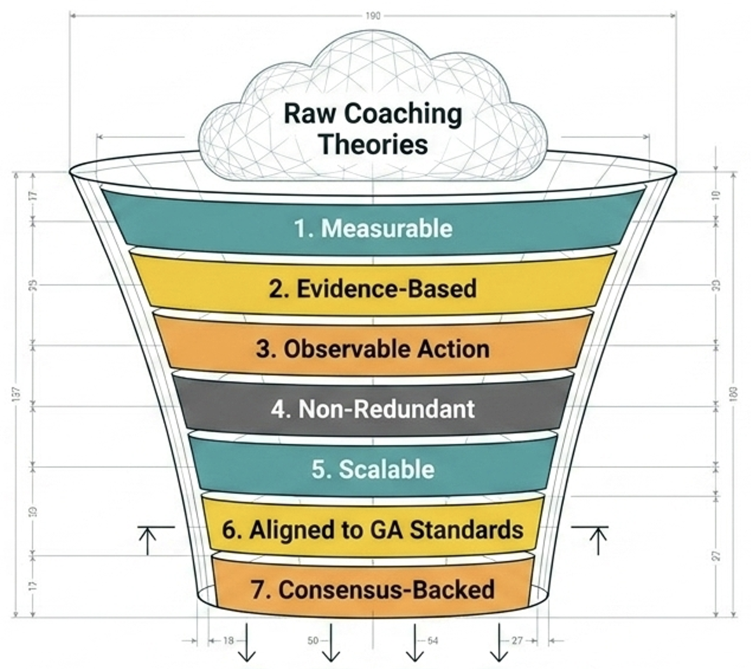
Leveraging CTF Expertise
v
Raw Expertise, Experience,
Theories, & Research
Literacy Coaching Competencies
Notes:
As a reminder, the competencies are Granular, measurable, specific actions or abilities
The process for creating the competencies intentionally leveraged the collective expertise and experiences of the CTF, working to collaboratively identify and describe the skills, knowledge, and abilities necessary for effective literacy coaching.
The Deal Center Team drafted competencies from the CTF descriptions.
Next, we used a process similar to how the standards were revised and refined, with the entire CTF collaboratively reviewing the drafts and providing feedback, which was used to further revise and refine the competencies until consensus was reached.

Slide 15
Competencies for each Standard
Creating and Fostering a Culture of Collaborative Literacy Leadership – 5 standards, 11 competencies
Knowledge and Application of Assessment to Inform Literacy Instruction – 4 standards, 11 competencies
Knowledge and Application of Literacy Development and Instruction – 9 standards, 26 competencies
Development and Implementation of Literacy-Focused Professional Learning – 6 standards, 11 competencies
Notes:
A total of 59 competencies were developed to align with each standard, within each domain.

Slide 16
Preamble
Contextualizes the Domains, Standards, and Competencies
Glossary
Limited
Focused
Clarified technical terms readers would be most likely to interpret inconsistently

Slide 17

THANK YOU

